Slide 1
Object Relationships
Lecturer: Ngo Huy Bien
Software Engineering Department
Faculty of Information Technology
VNUHCM - University of Science
Ho Chi Minh City, Vietnam
nhbien@fit.hcmus.edu.vn

Slide 2

Objectives
To present what is one-to-one, one-to-many, many-to-one, many-to-many relationship.
To create relationships.
To present what is association.
To create association.
To present what is aggregation.
To create aggregation.
To present what is composition.
To create composition.
To create a collaboration.

Slide 3

References
Jim Keogh and Mario Giannini. OOP Demystified: A Self-Teaching Guide. 2005.
Craig Larman. Applying UML And Patterns. Addison Wesley Professional. 2004.

Slide 4

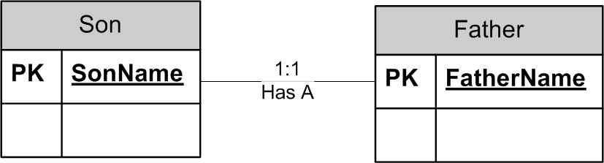
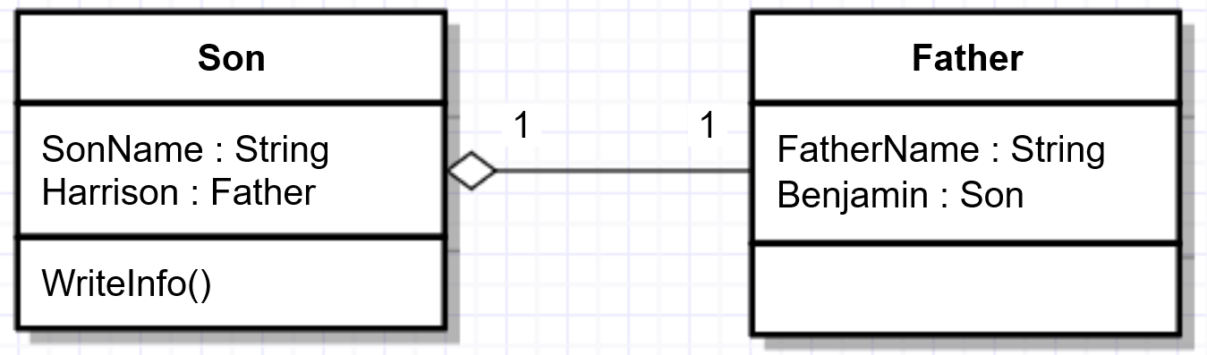
One-To-One Relationship [1]
One instance of an entity is related to only one instance of another entity.

Slide 5
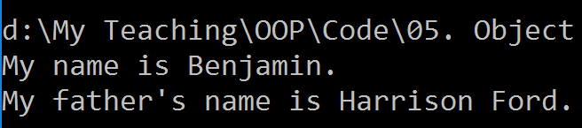
One-To-One Example

Slide 6

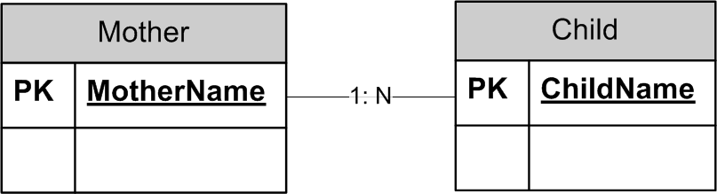
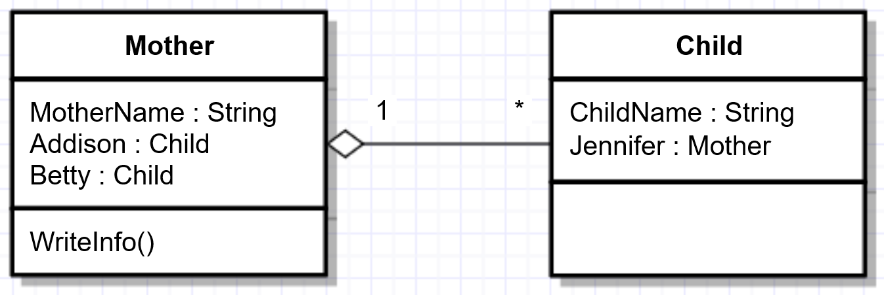
One-To-Many Relationship
One instance of an entity is related to many instances of another entity.

Slide 7
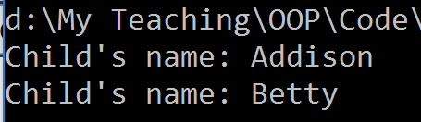
One-To-Many Example

Slide 8
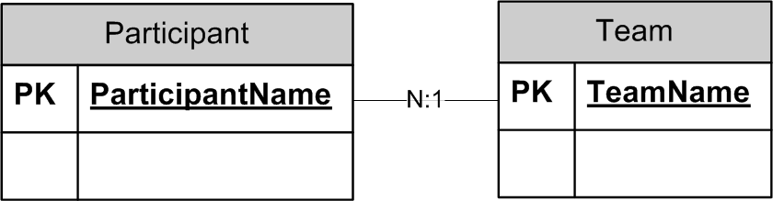

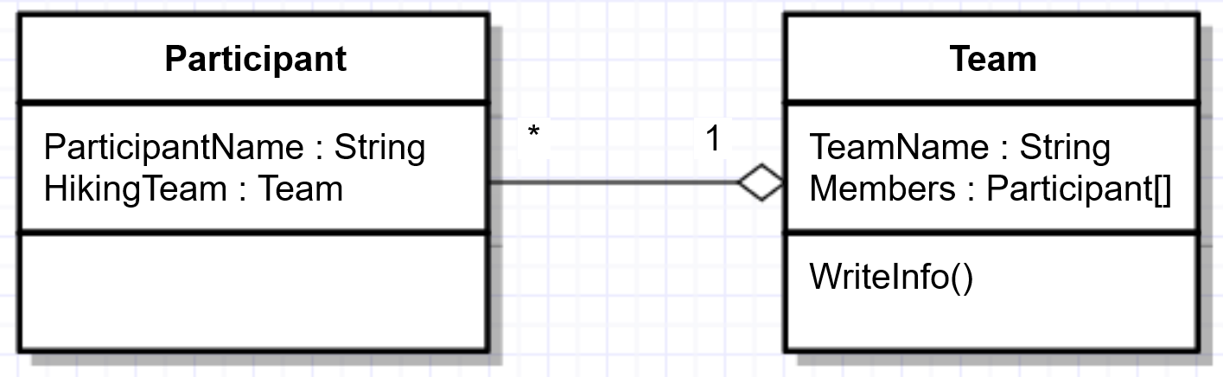
Many-To-One Relationship
Many instances of an entity is related to only one instance of another entity.

Slide 9

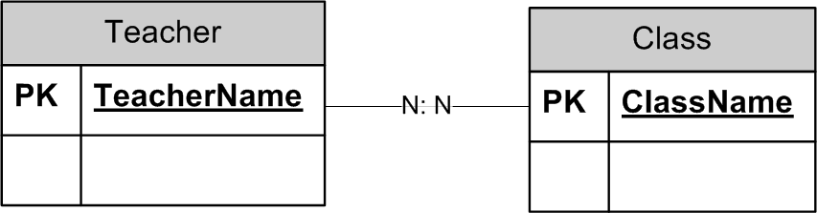
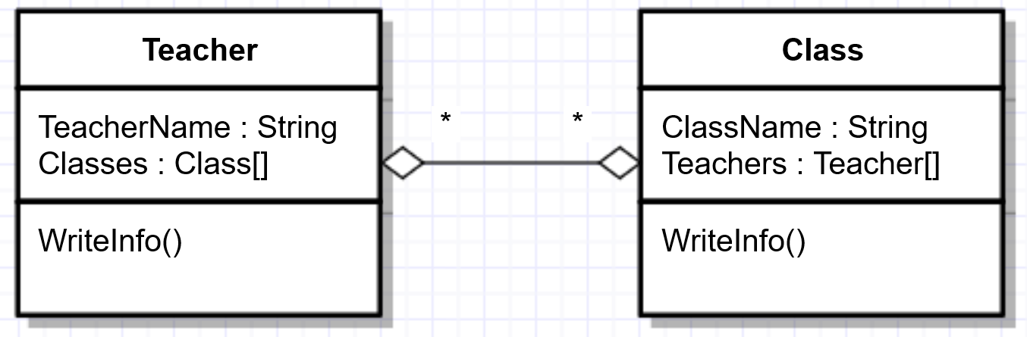
Many-To-Many Relationship
Many instances of an entity is related to many instances of another entity.

Slide 10
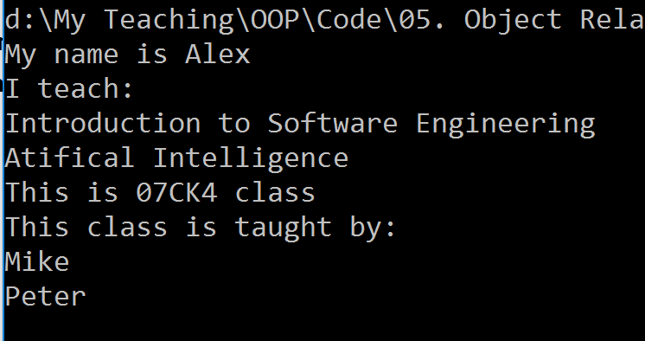
Many-To-Many Example

Slide 11


Association [1]
A object uses another object.
“Uses A” relationship

Slide 12

Association [2]
An association is a relationship between classes (more precisely, instances of those classes) that indicates some meaningful and interesting connection.
public class Flight
{
public void Flight(
Airport from , Airport to)
{
}
}
RELATED TO Relationship

Slide 13

Why Association?

Slide 14




Aggregation [1]
Complex object is composed of other objects.
“Has A” relationship

Slide 15
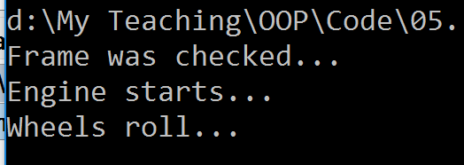
Car Example

Slide 16
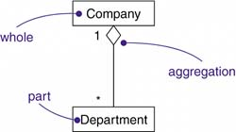
Aggregation [2]
An aggregation is a property of an association representing a whole-part relationship and (usually) life-time containment.
public class Department
{
private List<Teacher> teachers;
public void Department(List<Teacher> teachers)
{
this.teachers = teachers;
}
}
HAS A Relationship

Slide 17
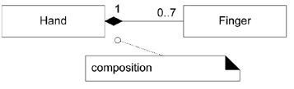
Composition
A composition relationship implies that
an instance of the part (such as a Finger) belongs to only one composite instance (such as one Hand) at a time,
the part must always belong to a composite (no free-floating Fingers), and
the composite is responsible for the creation and deletion of its parts either by itself creating/deleting the parts, or by collaborating with other objects.
public class Hand
{
private List<Finger> fingers;
public void Hand()
{
this.fingers = new
List<Finger>();
}
}
HAS A Relationship

Slide 18

Why Aggregation and Composition?

Slide 19


Slide 20

Collaboration [1]
Cooperation of objects to achieve a strategic objective.
Message
Responsibility
Message
Responsibility

Slide 21
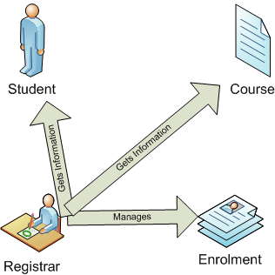
Class Responsibility Collaborator (CRC)
Class Registrar | Collaborators Student Course Enrolment
Responsibility Link Student and Course Remove Link between Student and Course Find Link between Student and Course

Slide 22

Collaboration Example

Slide 23

Thank You for Your Time

